Slide 1


Digital Image Processing

Slide 2
About EMR
Constantly working on
Developing industry relevant skills
Conducting hands-on workshops organized by pre-final and final year students.
Work in technologies like
Embedded Systems
Image Processing
Internet Of Things (IoT)
Machine Learning
Participated & won in various domestic and inter-college competitions – Micro-explorer, Micro-innovator, Robo-Soccer and E-Yantra.

Slide 3
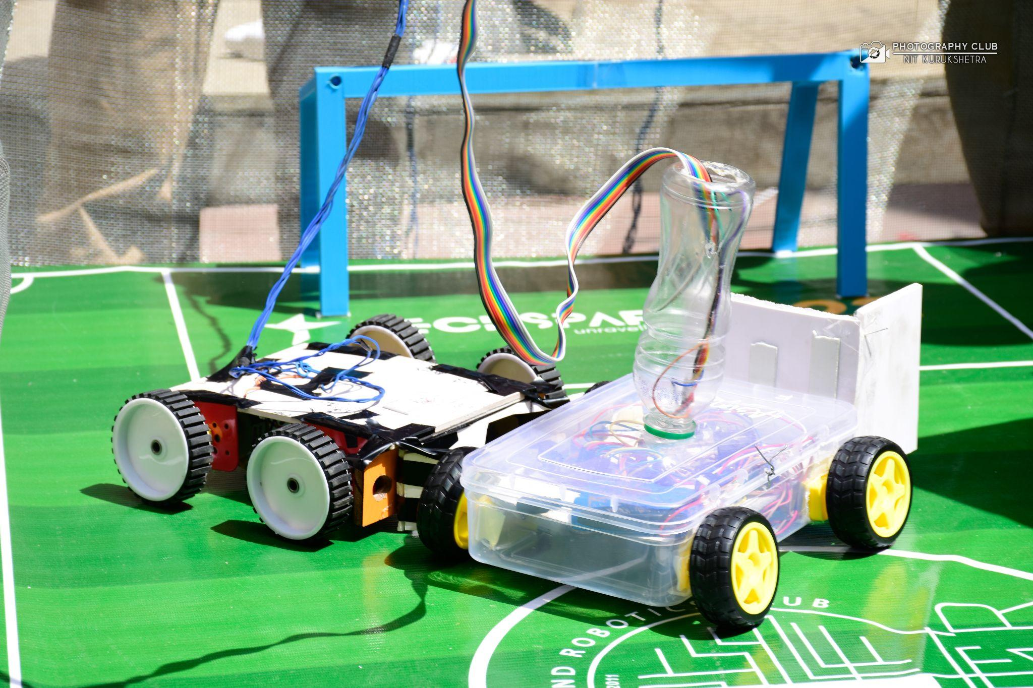
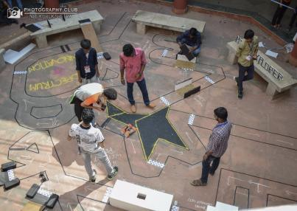
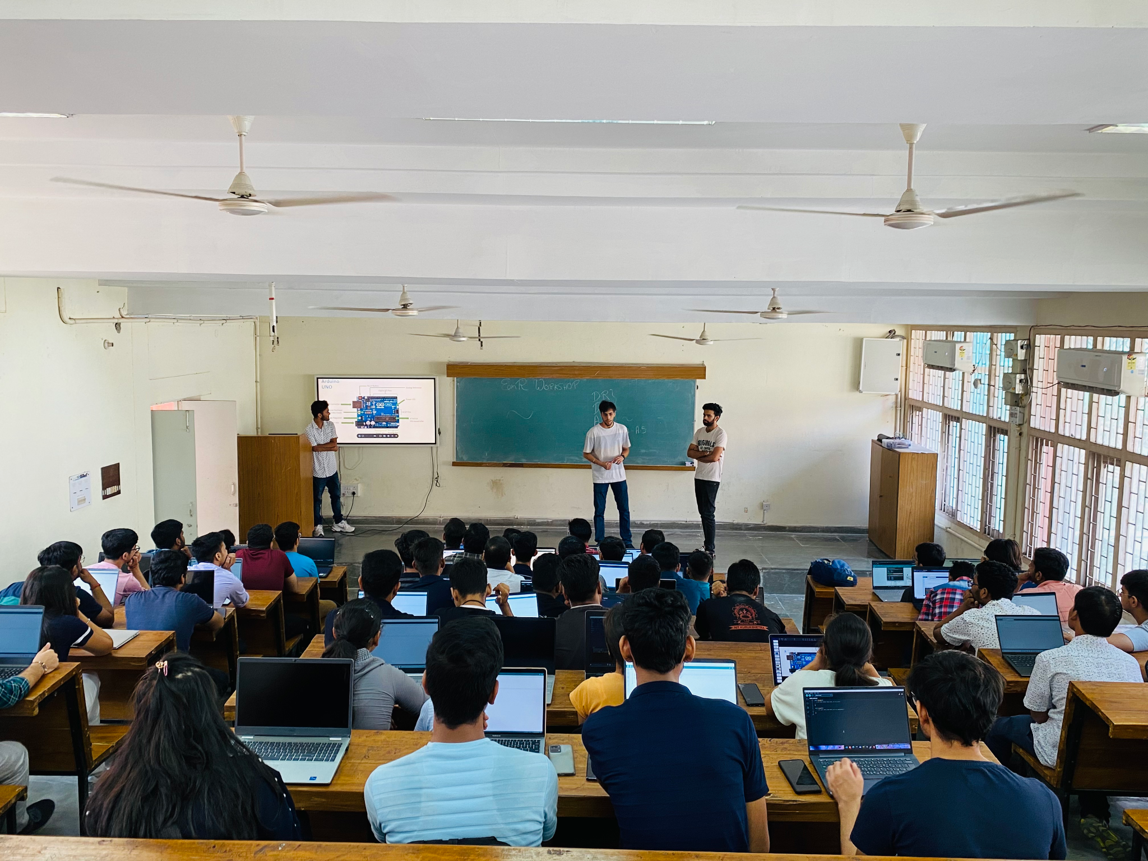

What We DO At EMR?
SOME LEARNING
SOME INNOVATION
SOME EXPERIMENT
SOME COMPETITION
A LOT OF FUN

Slide 4

About Image Processing
Use of a computer to process digital images through an algorithm
Refining of an image by removing noise from it to get a more clear picture, that may be further utilized in other stages, such as a face detection model

Slide 5

Application of Image Processing
Two principal application areas :
Improvement of pictorial information for human interpretation.
Processing of a scene data for an autonomous machine perception.
Applications – remote sensing, medical imaging, acoustic imaging, Forensic sciences and industrial automation.

Slide 6



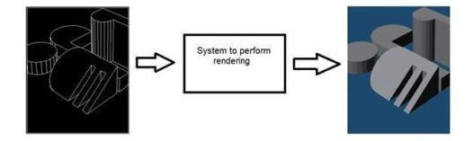


Overlapping fields
Computer Vision
Artificial Intelligence
Computer Graphics
Signal Processing

Slide 7
Introduction to Python

Slide 8
Key points for the C acquainted…
Indentation dictates block structure
First assignment to a variable creates it
Variable types don’t need to be declared – Python figures it out on its own
Supports typecasting
Assignment is = and comparison is ==
For numbers +, *, /, % are as expected
Special use of + for string concatenation and % for string formatting (as in C printf)
Logical operators are words (and, or, not) not symbols
The basic printing command is print

Slide 9
Salient Features
Object oriented language
Interpreted language
Supports dynamic data type
Platform independent
Focused on development time
Simple and easy grammar
High-level internal object data types
Automatic memory management
It’s free (open source)!

Slide 10


Slide 11
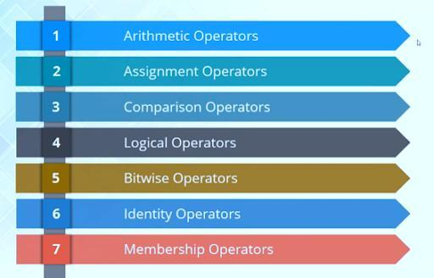
Basic operators

Slide 12
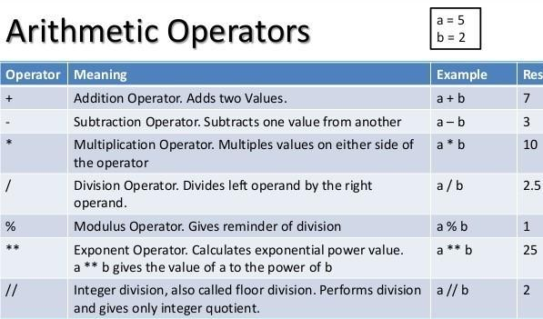
Basic operators

Slide 13
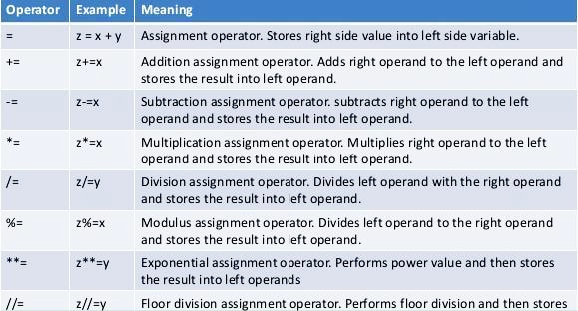
Assignment Operators

Slide 14
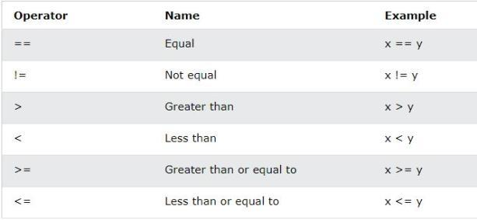
Comparison Operators

Slide 15
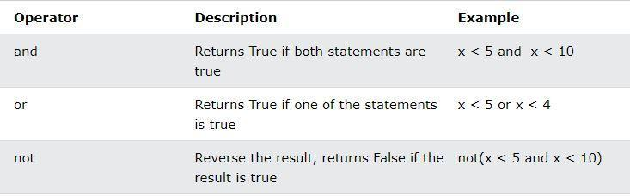
Logical Operators

Slide 16
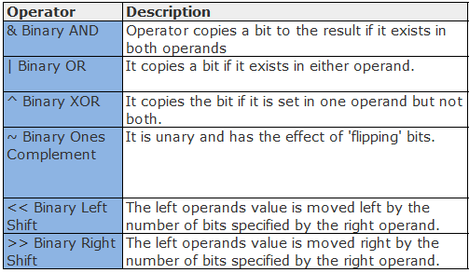
Bitwise operators

Slide 17
Additional Operators
In operator: It is a Boolean test whether a value is inside a container or not (in lists and tuples). For strings, it checks whether the passed operand is a substring of given string.
Example: a=[1,2,5], s="abcde"
4 in a => "False"
"ce" in s => "True"
+ operator: It is used to create a new tuple, list or string from existing ones, by concatenating the two.
(1, 2, 3) + (4, 5, 6) => (1, 2, 3, 4, 5, 6)
“Hello” + “ ” + “World” => ‘Hello World’
The * operator produces a new tuple, list, or string that “repeats” the original content.
(1, 2, 3) * 3 => (1, 2, 3, 1, 2, 3, 1, 2, 3)

Slide 18
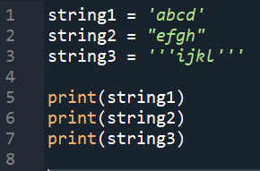
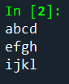
Strings
Strings can be defined with ‘ ’, “ “, ‘’’ ‘’’.
Example:
+ operator is used to concatenate strings. e.g. c = ‘a’ + ‘b’ => c = ‘ab’
* operator is used to repeat the strings. e.g. ‘a’*5 => ‘aaaaa’

Slide 19
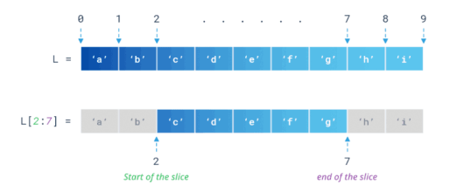
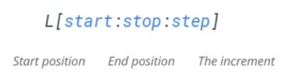
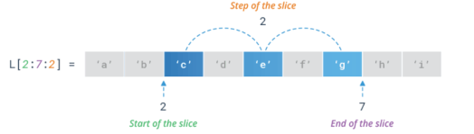
Slicing
You can return a range of characters by using the slice syntax.
Specify the start index and the end index, separated by a colon, to return a part of the string.
Syntax:- Example:

Slide 20
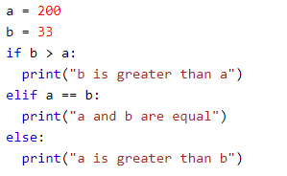
Python If ... Else
if: An "if statement" is written by using the if keyword.
elif : The elif keyword is pythons way of saying "if the previous conditions were not true, then try this condition".
else: The else keyword catches anything which isn't caught by the preceding conditions.
Example:-

Slide 21
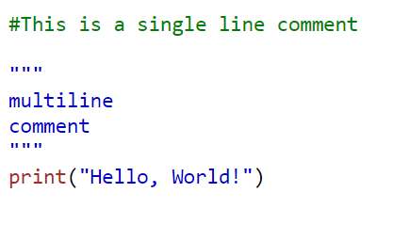
Python Comments
Start comments with #, rest of line is ignored
Can include a “documentation string” as the first line of a new function or class you define
Development environments, debugger, and other tools use it: it’s good style to include one
Example:-

Slide 22
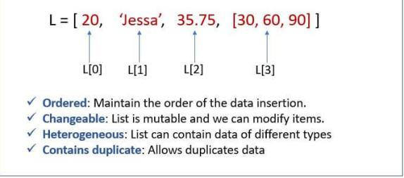
Lists
Datatype storing sequential collection of values with heterogenous nature.
Values are enclosed in [], for eg: [-1,'a',TRUE]
Lists support two way indexing.
Positive index is used to count from the left, starting with 0 and negative index is used to count from right, starting with –1
Example:-

Slide 23
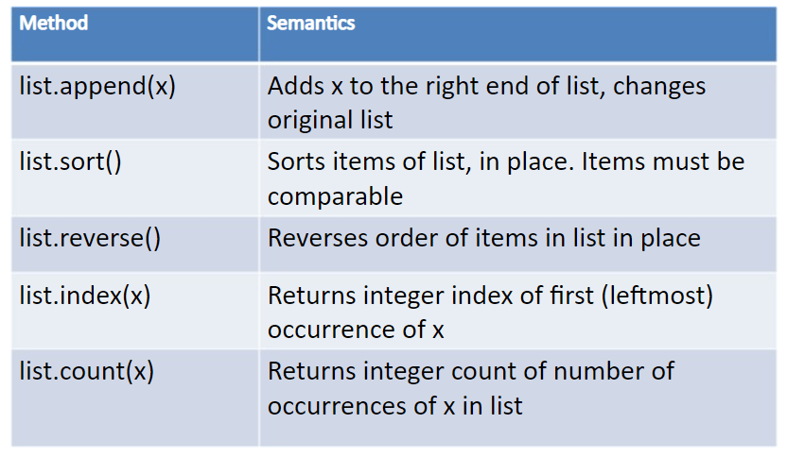
Lists methods

Slide 24
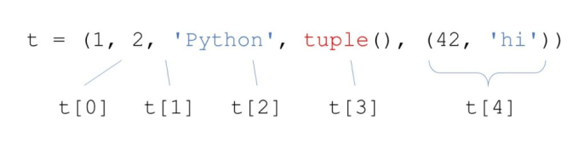
Tuples
Tuples are used to store multiple items in a single variable.
Tuple items are ordered, unchangeable, and allow duplicate values.
Tuple items are indexed, the first item has index [0], the second item has index [1] etc.
Example :-

Slide 25
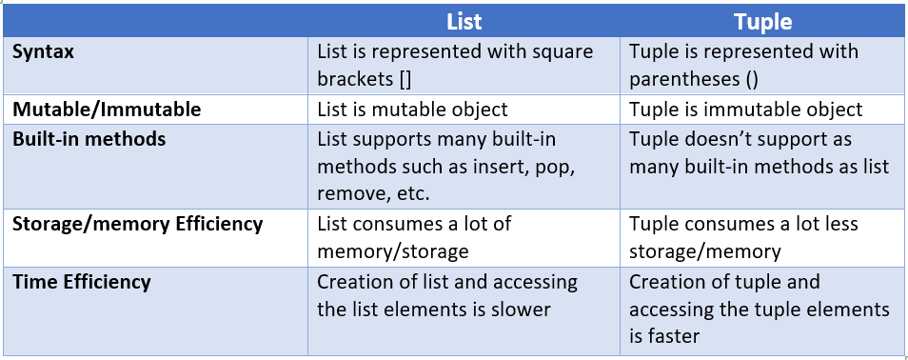
Tuples vs. Lists

Slide 26
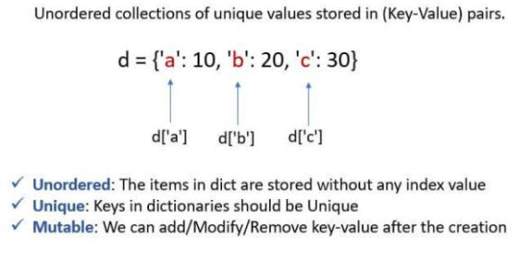
Dictionary
Unordered collection of data with a Key: Value pair.
A dictionary is a collection which is unordered, changeable and does not allow duplicates.
Dictionaries are written with curly brackets, and have keys and values:

Slide 27
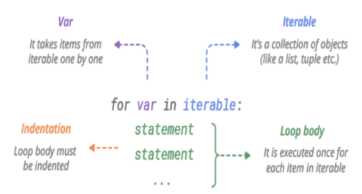
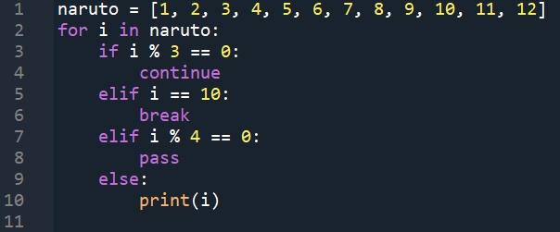
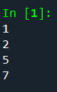
For loop
For loops are used to loop through an iterable object (like a list, tuple, set, etc.)
Syntax: Example:

Slide 28
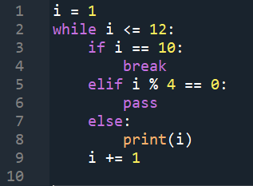
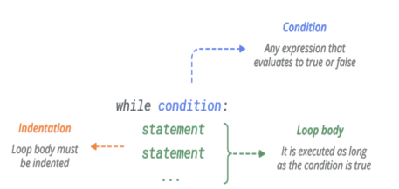
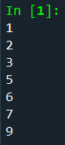
While loop
With the while loop, we can execute a set of statements as long as a condition is true
or we provide a "break" keyword.
Syntax: Example:

Slide 29
Functions
A function is a block of code which only runs when it is called. You can pass data, known as parameters, into a function. A function can return data as a result.
Arguments: Information can be passed into functions as arguments. Arguments are specified after the function name, inside the parentheses. You can add as many arguments as you want, just separate them with a comma.
Functions returns None by default but to return a value, use the return statement.
Function definitions cannot be empty, but if you for some reason have a function definition with no content, put in the pass statement to avoid getting an error.

Slide 30
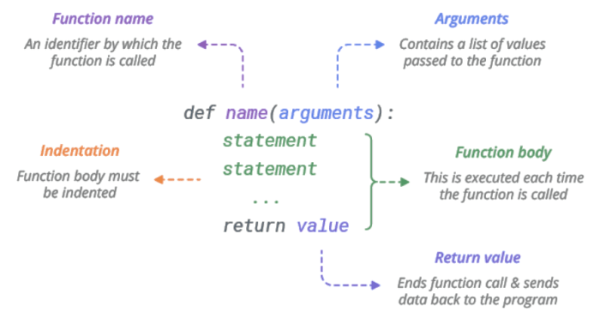
Functions

